Slide 1

Film Analytics
Unveiling the Cinematic Landscape
This Photo by Unknown author is licensed under CC BY-SA.

Slide 2
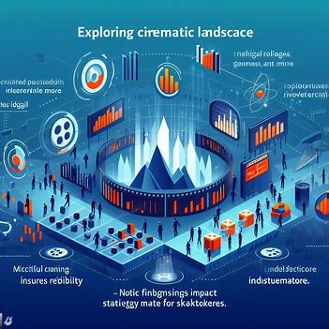
ABSTRACT
Exploring the Cinematic Landscape delves into diverse movie data, revealing industry trends for filmmakers and enthusiasts.
Meticulous data cleaning ensures reliability, followed by insightful visualizations on genres, revenue, and more.
Notable findings impact strategic decision-making for stakeholders.
This Photo by Unknown author is licensed under CC BY-SA.

Slide 3
PROJECT OVERVIEW
The project is about analyzing a large dataset of movies with various attributes.
The project aims to discover patterns, trends, and insights in the film industry.
The project uses data analysis and visualization techniques to present the findings.
This Photo by Unknown author is licensed under CC BY-SA.

Slide 4
OBJECTIVE
Exploratory Data Analysis (EDA)
Visualization
Identification of Trends
Stakeholder Insights
This Photo by Unknown author is licensed under CC BY-SA.

Slide 5
IMPORTANCE OF THE PROJECT
Strategic Decision-Making
Audience Engagement and Satisfaction
Industry Trends and Evolution
This Photo by Unknown author is licensed under CC BY-SA.

Slide 6
TOOLS AND TECHNOLOGIES USED
Python programming language and associated libraries for data analysis
Pandas and NumPy are commonly employed for data manipulation
Matplotlib and Seaborn facilitate the creation of insightful visualizations
Big data processing tools such as Apache Spark
This Photo by Unknown author is licensed under CC BY-SA.

Slide 7
METHODOLOGY
DATA COLLECTION - dataset utilized in this project is sourced from The Movie Database (TMDb)
DATA PREPROCESSING -involves handling missing values, removing duplicates, and addressing inconsistencies in the records
DATA VISUALIZATION - to convey insights from this complex dataset
This Photo by Unknown author is licensed under CC BY-SA.

Slide 8
DATA FIELDS
ID (Unique Identifier)
Title
Release Date
Revenue
Average Rating
Vote Count
Status
Runtime
Adult Content Indicator
This Photo by Unknown author is licensed under CC BY-SA.

Slide 9
DATA FIELDS
ID (Unique Identifier)
Title
Release Date
Revenue
Average Rating
Vote Count
Status
Runtime
Adult Content Indicator
This Photo by Unknown author is licensed under CC BY-SA.

Slide 10
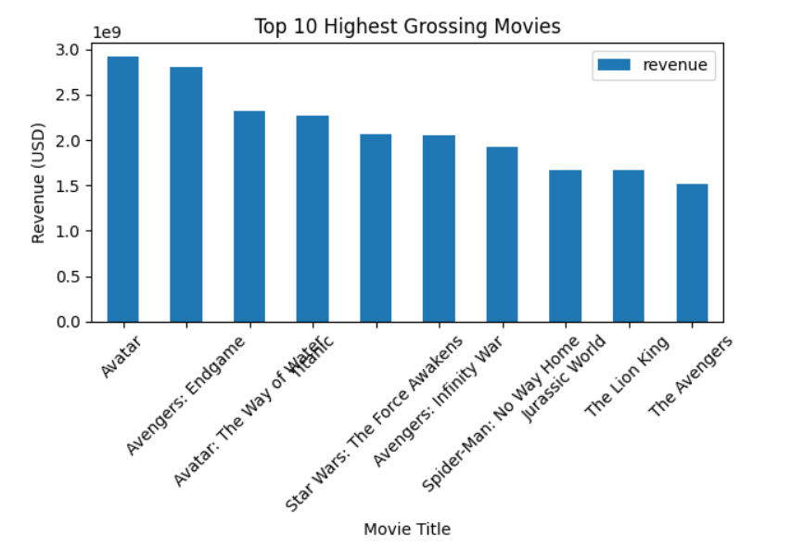
Top 10 Highest Grossing Movies
This Photo by Unknown author is licensed under CC BY-SA.

Slide 11
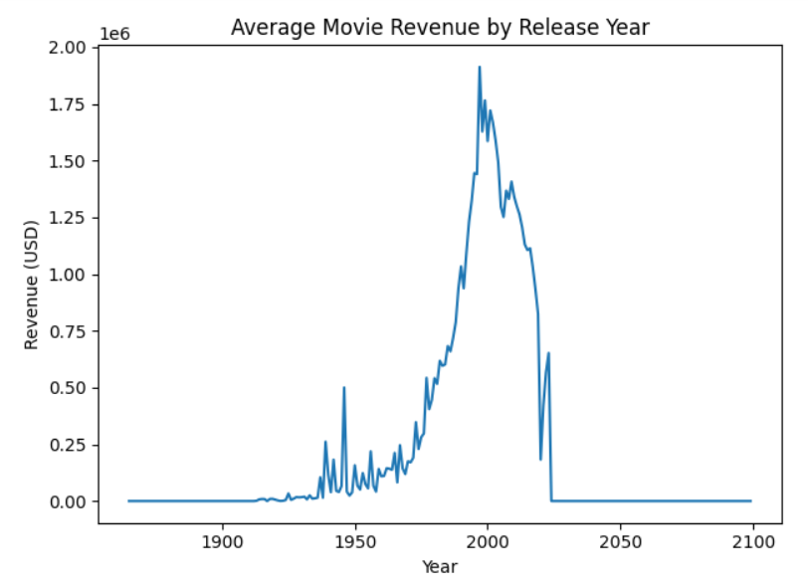
Average Movie Revenue by Release Year
This Photo by Unknown author is licensed under CC BY-SA.

Slide 12
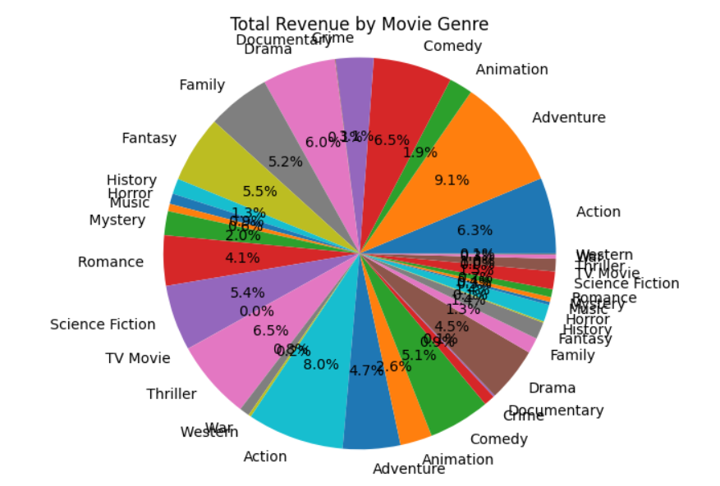
Total Revenue by Movie Genre
This Photo by Unknown author is licensed under CC BY-SA.

Slide 13
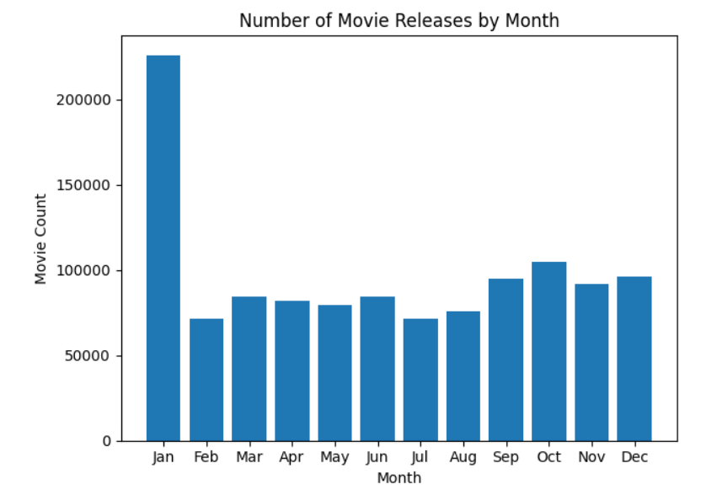
Number of Movie Releases by Month
This Photo by Unknown author is licensed under CC BY-SA.

Slide 14
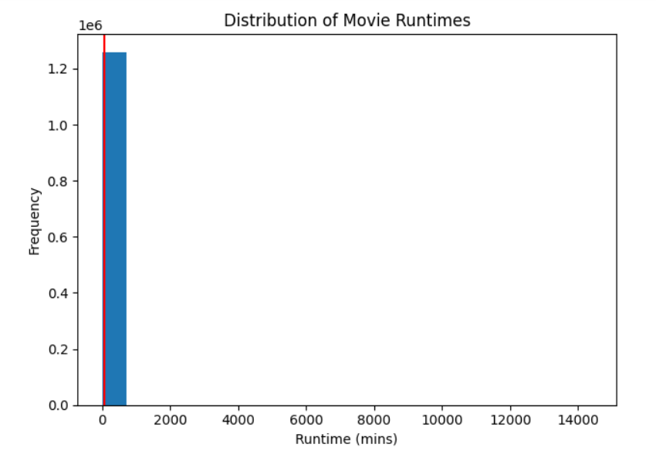
Distribution of Movie Runtimes
This Photo by Unknown author is licensed under CC BY-SA.

Slide 15
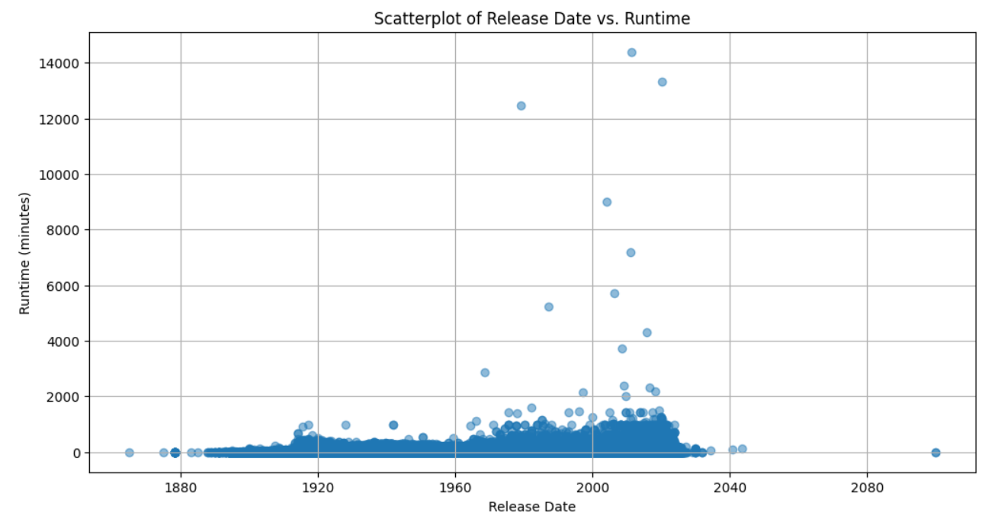
Scatterplot of Release Date vs. Runtime
This Photo by Unknown author is licensed under CC BY-SA.

Slide 16
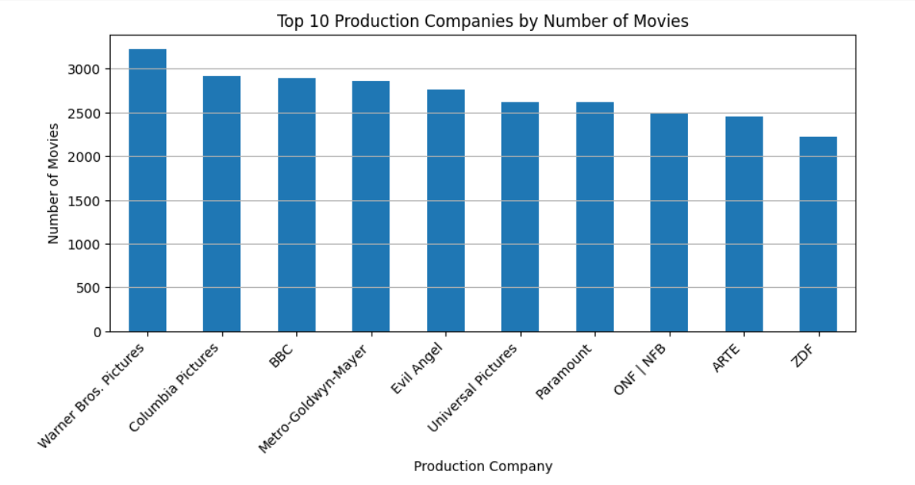
Top 10 Production Companies by Number of Movies
This Photo by Unknown author is licensed under CC BY-SA.

Slide 17
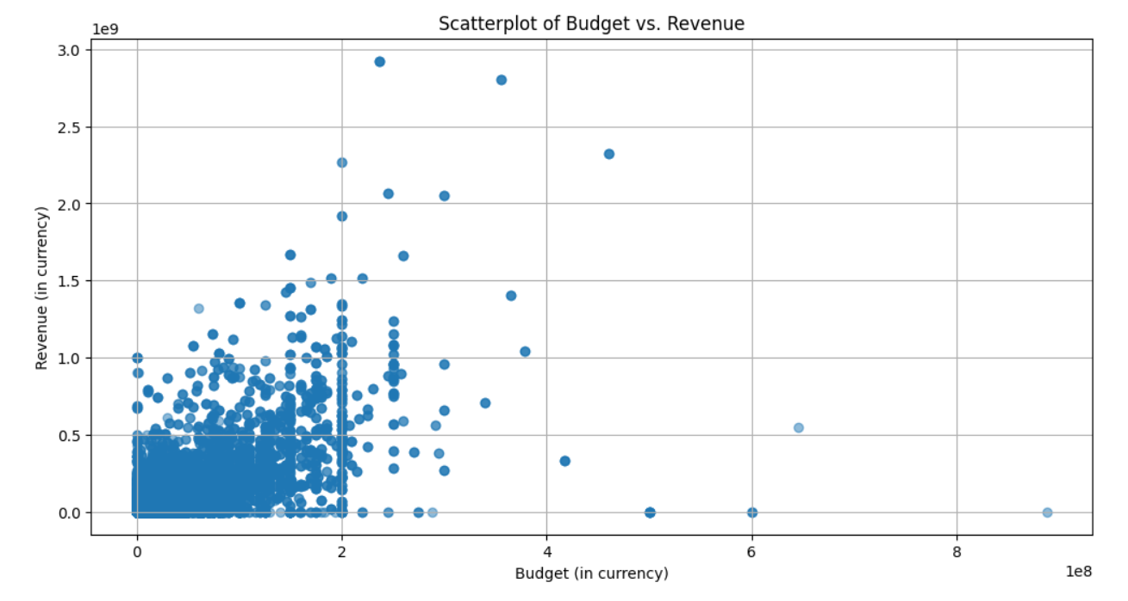
Scatterplot of Budget vs. Revenue
This Photo by Unknown author is licensed under CC BY-SA.

Slide 18
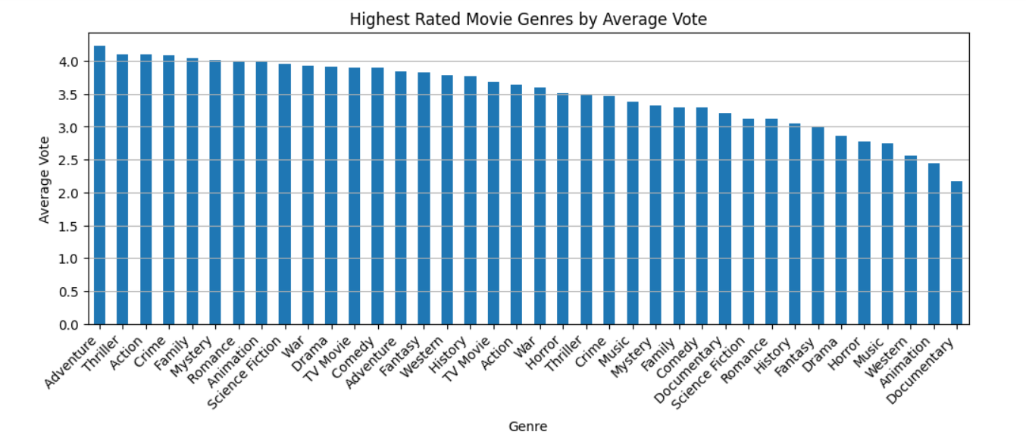
Highest Rated Movie Genres by Average Vote
This Photo by Unknown author is licensed under CC BY-SA.

Slide 19
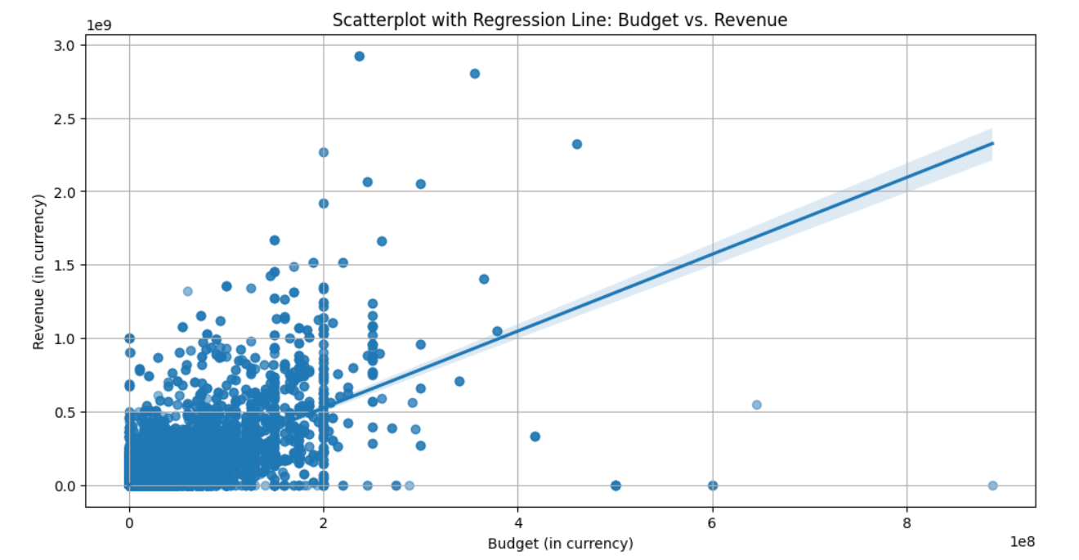
Scatterplot with Regression Line: Budget vs. Revenue
This Photo by Unknown author is licensed under CC BY-SA.

Slide 20
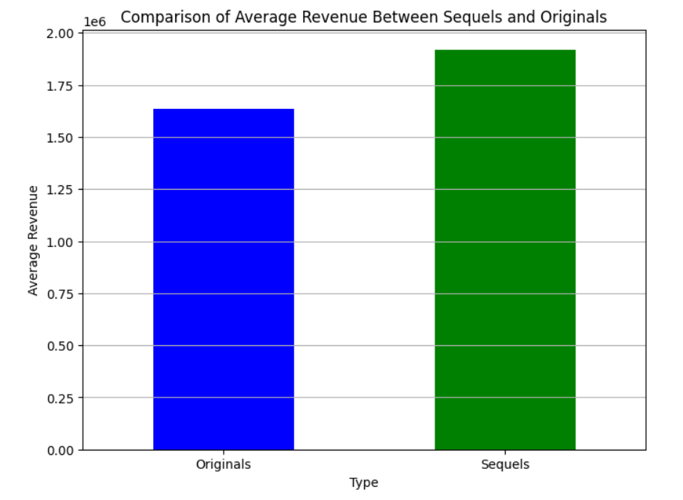
Comparison of Average Revenue Between Sequels and Originals
This Photo by Unknown author is licensed under CC BY-SA.

Slide 21
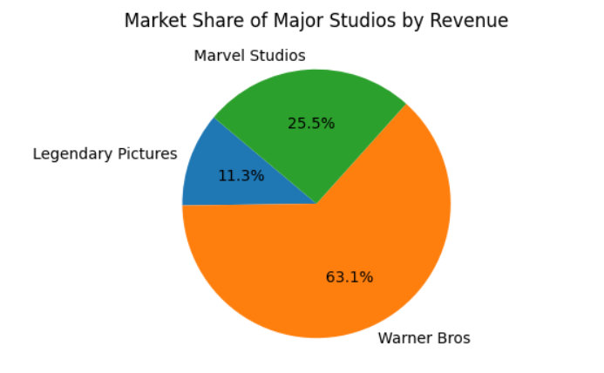
Market Share of Major Studios by Revenue
This Photo by Unknown author is licensed under CC BY-SA.

Slide 22
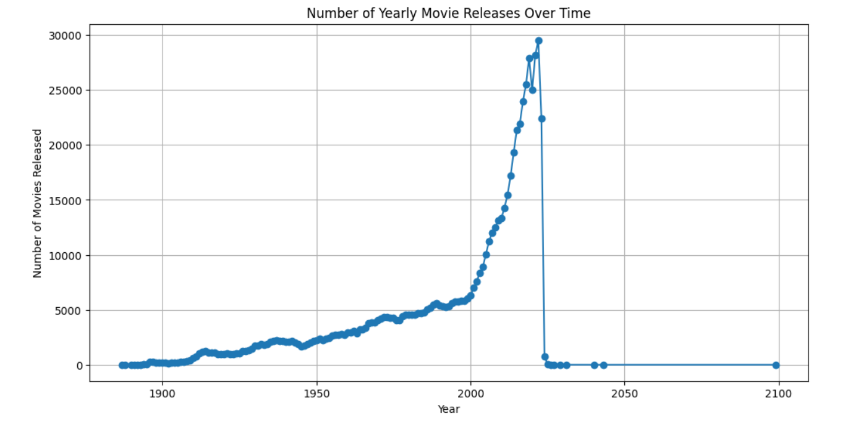
Number of Yearly Movie Releases Over Time
This Photo by Unknown author is licensed under CC BY-SA.

Slide 23
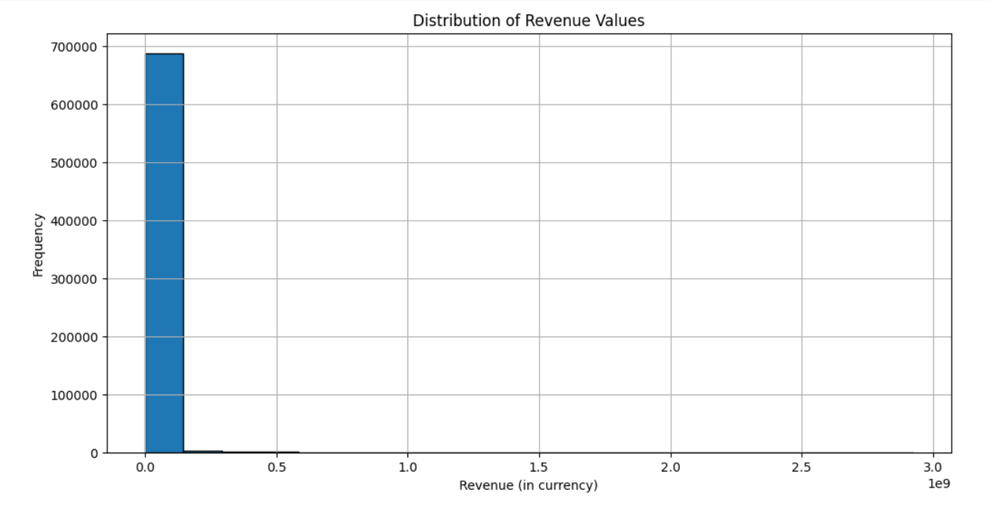
Distribution of Revenue Values
This Photo by Unknown author is licensed under CC BY-SA.

Slide 24
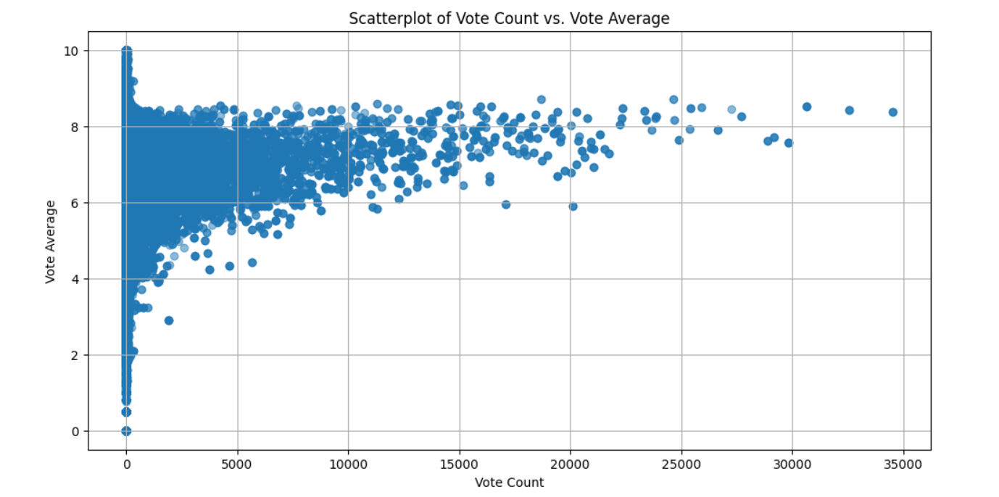
Scatterplot of Vote Count vs. Vote Average
This Photo by Unknown author is licensed under CC BY-SA.

Slide 25
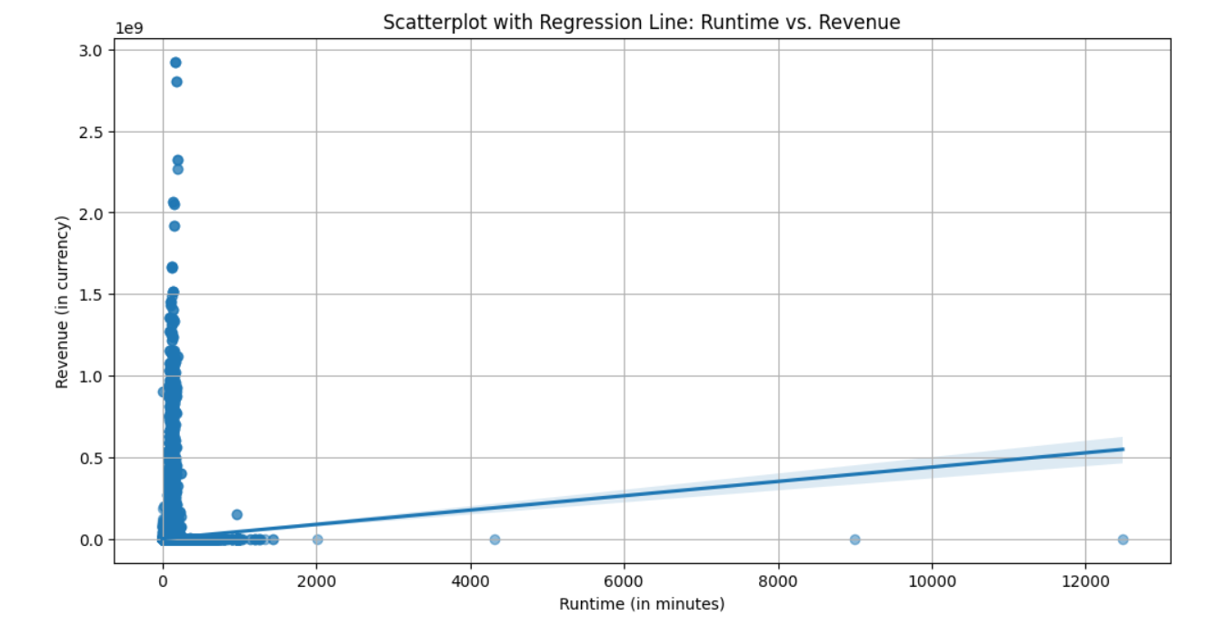
Scatterplot with Regression Line: Runtime vs. Revenue
This Photo by Unknown author is licensed under CC BY-SA.

Slide 26
THANK YOU
This Photo by Unknown author is licensed under CC BY-SA.

